Slide 1
Can a pretrained neural language model still benefit from
linguistic symbol structure ?
Jakob Prange
11th May, 2023
Some upper and some lower bounds

Slide 2


A Short History Lesson
Driving novelties | Criticism, Skepticism
Computational-cognitive thinking Formal languages | True universality? Quantifiability? Falsifiability?
Data-centricity Quantifiability Scalability | Scalability, hardware, reliability, practical usefulness
Multihead & multi-layer attention MLM next-sentence prediction | Syntax yes, logical structure no? Compositional generalization?
Human feedback Multimodal Coherence, Dialog | Knowledge, Truth???
Rule-based systems, chart-parsers, …
“Golden Age of symbolic linguistics”
Syntax trees, Logic, Formal Grammars Connectionism
1950s
Markov models, SVMs, CRFs
LSTMs, Convolutional nets
Models are starting to get more powerful but also less interpretable
Statistical Machine Learning
1990s
Deep Learning
early 2000s
Transformers, BERT
2017, 2019
“Rediscover the classical NLP pipeline”?
GPT-3, ChatGPT, GPT-4
Models seem to really “get” meaning and remember things

Slide 3


Deep Learning from a linguistic-cognitive perspective
Successes and Questions
Cognitive interpretability and (im)plausibility
Big wins in task-specific performance
Continuous criticism, skepticism, scientific curiosity about linguistic-cognitive capabilities
Many major technological novelties originated in linguistic-cognitive theories (LSTM, attention, …)
5-10 years ago: trying to analyze the behavior of individual neurons
BERTology (last 5 years): analyzing the behavior of network layers →”functional connectivity”
The better the task performance, the worse the correlation with human judgments

Slide 4
Overview
Linguistics & Neuro-symbolic LM
Upper bounds (and their problems)
Lower bounds (and the unexpected difficulty of reaching them)
Is it worth it?

Slide 5


Neuro-Symbolic Language Models

Slide 6
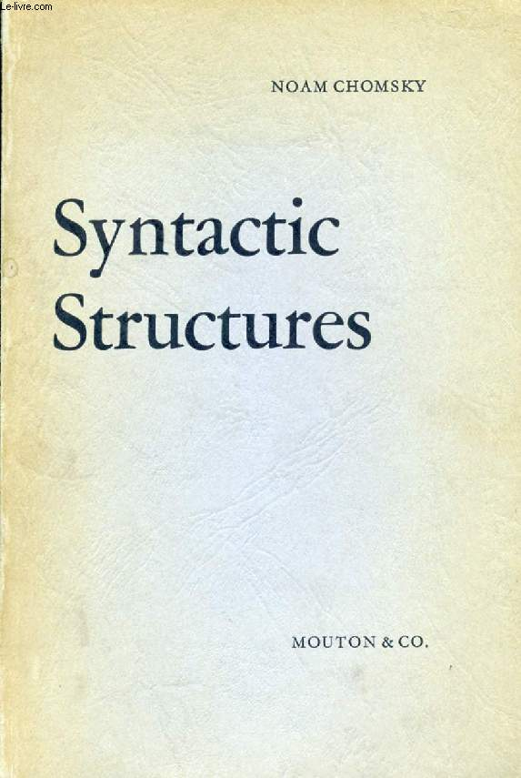
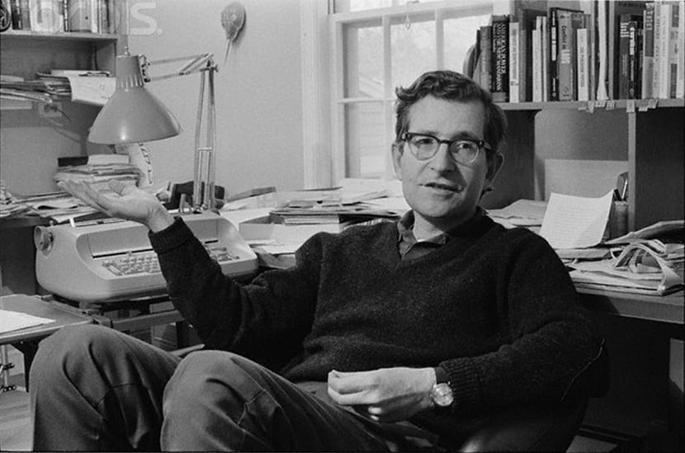

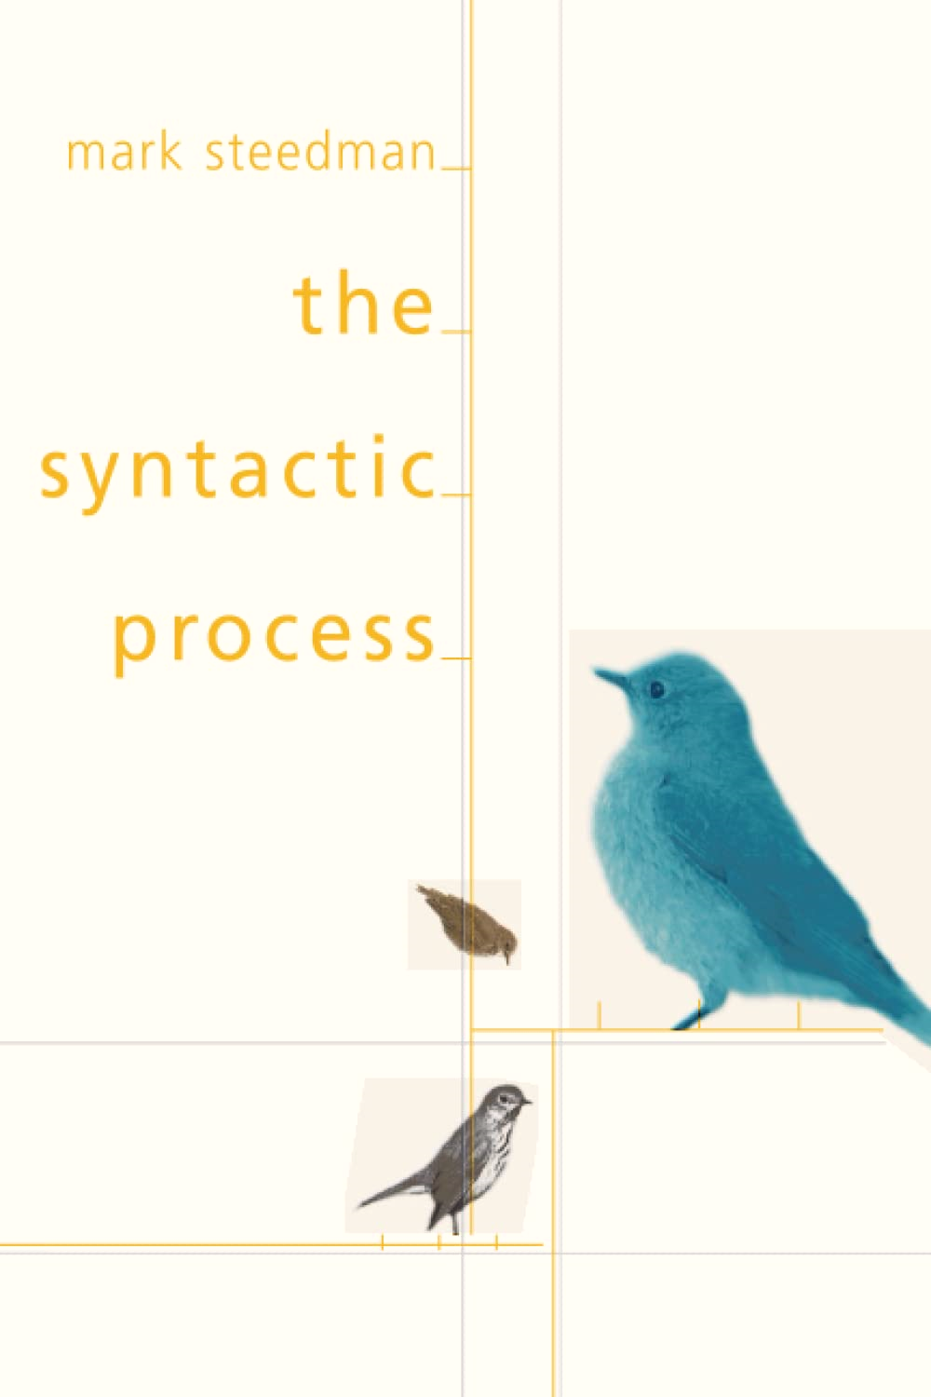
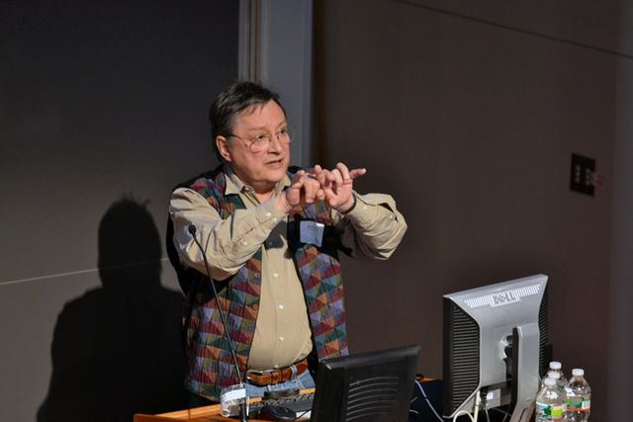
[Nivre+ 2016, 2020]
UD
[Marcus+ 1993; Hovy+ 2006]
PTB
Alice did not know what to say
Syntax
SLR
Symbolic/Structured Linguistic Representation
Dependencies
Noun | Aux | Neg | Verb | Noun | Aux | Verb
Alice did not know what to say
Constituencies
Person | Past | Negation | Cognition | Content | Intent | Communication
UCCA
Semantics
AMR
[Banarescu+ 2013]
[Abend & Rappoport 2013]

Slide 7
Whoa there, not so fast!
Syntactic Constituent Tree
from the Penn Treebank (PTB)
Semantic Argument-structure Graph
in the UCCA Framework
Cognitive Concepts
Scenes
Process vs State
Shared Argumenthood
Grammar Rules
S → NP VP
VP → (AUX) (NEG) V
VP → (AUX) (NEG) V VP
VP → NP AUX V
NP → N

Slide 8
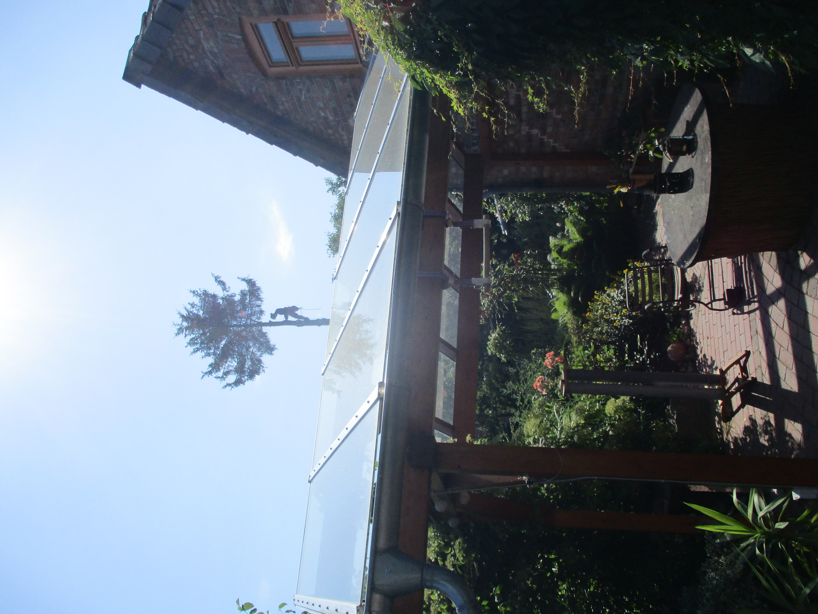
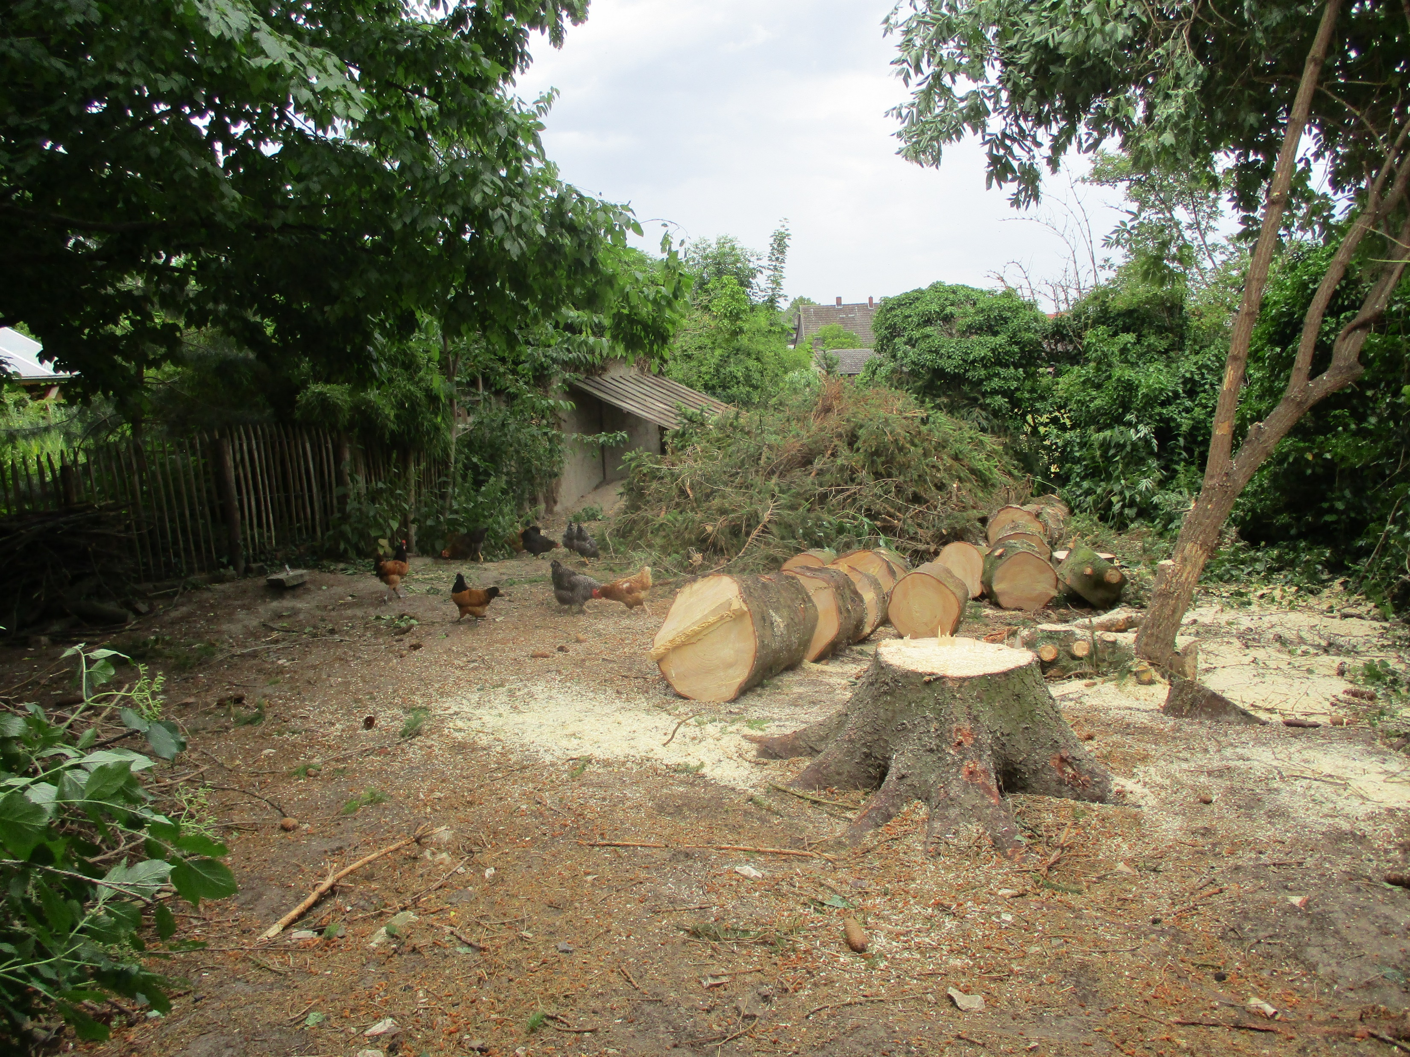
Slicing up Linguistic Graphs

Slide 9
Slicing up Linguistic Graphs

Slide 10
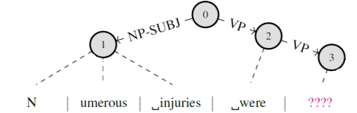
Slicing up Linguistic Graphs

Slide 11
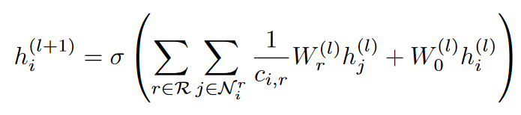
Encoding Graphs as Vectors
R-GCN [Schlichtkrull+ 2018; Kipf & Welling 2017]
Inefficient in the incremental setting
Edge labels + anchor token embeddings
"High resolution"
0 | 1 | 0
1 | 0 | 0
0 | 0 | 0
"Low resolution"
Structural relations

Slide 12
Encoding Graphs as Vectors
NP-SUBJ
VP
…
Parent
0 | 1 | 0
1 | 0 | 0
0 | 0 | 0
Lookups
Sibling
…

Slide 13
Neuro-Symbolic LM
logits_{Neural}
GPT-2
logits_{Symbolic}
NP-SUBJ
VP
…
Flatten & Feed-forward
Parent
0 | 1 | 0
1 | 0 | 0
0 | 0 | 0
Lookups
Sibling
…

Slide 14
But where does the Symbol Structure Come from?

Slide 15
Overview
Linguistics & Neuro-symbolic LM
Upper bounds (and their problems)
Lower bounds (and the unexpected difficulty of reaching them)
Is it worth it?

Slide 16
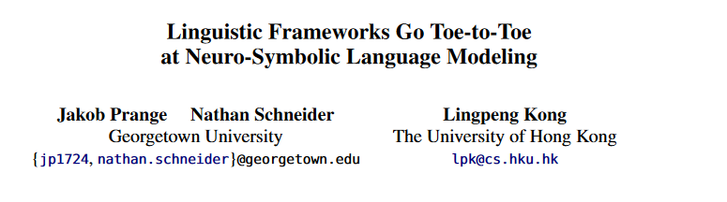
Upper Bounds
Published in NAACL-HLT 2022, Seattle
(We don’t care where it comes from, we just assume we have it)

Slide 17
Experimental Setup
Annotated text corpus
Use ground truth graphs at training and test time
Controls for parser performance
Upper bound for LM performance potential
11th May, 2023
Jakob Prange

Slide 18

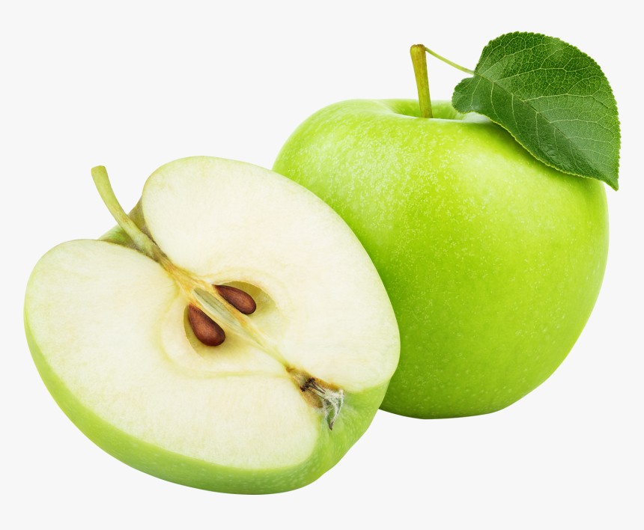

Experimental Setup
7 sentence-structure SLRs with different properties
Semantic constituencies: 2 (EDS, PTG)
Syntactic constituencies: 2 (PTB with 2 different label sets)
Semantic dependencies: 2 (DM, PSD)
Syntactic dependencies: 1 (UD)
All annotated over the same text corpus → Relatively fair comparison (the subset of English WSJ used in the MRP shared tasks)
w₁
w₂
w₃
w₁
w₂
w₃
11th May, 2023
Jakob Prange

Slide 19
[Nivre+ 2016, 2020]
UD
[Marcus+ 1993; Hovy+ 2006]
PTB
Alice did not know what to say
Syntax
Dependencies
Noun | Aux | Neg | Verb | Noun | Aux | Verb
Alice did not know what to say
Constituencies
Person | Past | Negation | Cognition | Content | Intent | Communication
UCCA
Semantics
AMR
[Banarescu+ 2013]
[Abend & Rappoport 2013]

Slide 20
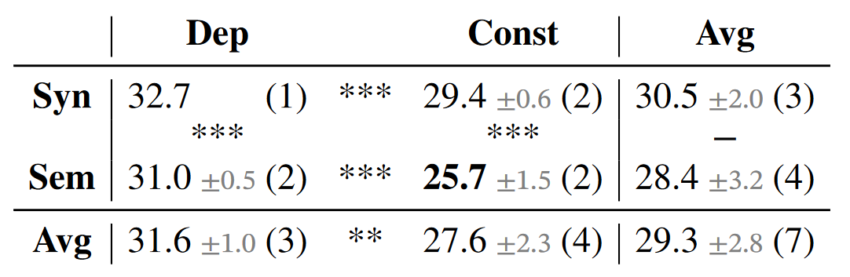
Results in Perplexity (lower is better)
***
***
**
***
***
***
--

Slide 21
Graph-to-Vector: R-GCN Encoding vs Concatenation

Slide 22


Problems with upper bound assumptions
Availability
Annotatability
Predictability
Richness

Slide 23
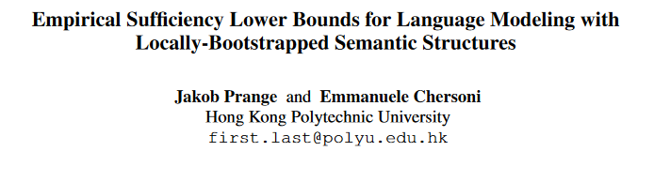
Lower Bounds
To appear in *SEM 2023, Toronto
(What if we jointly predict words and structure – how good does our structure parser need to be?)

Slide 24
A Joint Model

Slide 25
A Joint Model
¯\_(ツ)_/¯

Slide 26
Two “Adversarial” Approaches
Reduce Signal
Obscure Signal
⤮

Slide 27
Reduce Signal

Slide 28
Reduce Signal
¯\_(ツ)_/¯

Slide 29
Obscure Signal
¯\_(ツ)_/¯

Slide 30
Signal/Noise Distributions Matter!

Slide 31
Is it worth it?
If you have the resources to build the next ChatGPT and want to earn a lot of money: Probably not.
If you want to learn about language and build cognitively plausible models: Maybe.
¯\_(ツ)_/¯

Slide 32
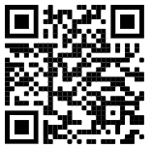
THANK YOU!
NAACL-HLT 2022
*SEM 2023
jakob.prange@polyu.edu.hk

